Slide 1


The role of distribution services in multichannel and omnichannel behavior
Madrid, January 26-28 2017

Slide 2
THE PURPOSES
First, to provide the basis for understanding how the deployment of new distribution channels by companies generates a natural segmentation governed by consumers’ self-selection and enhancing omnichannel behaviour
Second, to provide an empirical segmentation analysis identifying the variables explaining the self-selection

Slide 3
OUTLINE
1. The pervasiveness of online channels and the growth of omnichannel behaviour
2. The need for segmentation
3. The distribution services and the key role of separability
4. Omnichannel behaviour: the consumer perspective. The distinction between two customer roles: purchase and use
5. The segmentation process according to the customer roles
6. The empirical framework
7. The segmentation outcome
8. The analysis
9. Results and Discussion

Slide 4
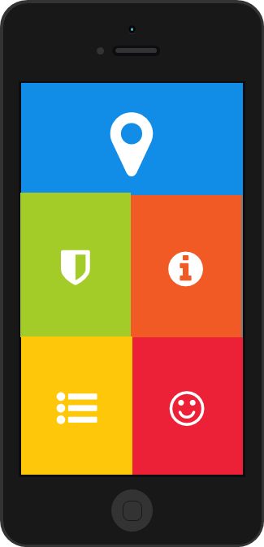
The pervasiveness of online channels
The deployment of online channels by companies has reached penetration rates close to total
In Europe (2014) 80% of companies were selling online using their own websites or apps (internal channels)
Around one third used small (35%) or large (33%) commercial platforms (external channels) and 22% used EDI-type transactions
(Source: Companies engaged in online activities EC EUROBAROMETER 2015)

Slide 5
The growth of omnichannel behaviour
Spain: in 2016, 35% of population (16-74 years) purchase online (Source: INE)
Spain: in 2015, 46% of consumers purchasing online say their buying behavior is influenced by reviews, and 31% compared prices using mobile in store (Source: PwC 2016 Total Retail Survey http://www.pwc.com/gx/en/industries/retail-consumer/global-total-retail.html)

Slide 6
The growth of omnichannel behaviour
Global: in 2015, 46% buys products via mobile at least a few times a year (Source: PwC 2016 Total Retail Survey http://www.pwc.com/gx/en/industries/retail-consumer/global-total-retail.html)
USA: in 2016, for consumers who make at least two online purchases in a three-month period, 51% of their purchases were made online (http://fortune.com/2016/06/08/online-shopping-increases)

Slide 7
THE NEED FOR SEGMENTATION
Customers do what they want in a wide variety of ways in every purchase
Can we provide a sensible segmentation useful for companies in understanding their customer base behavior?
To give a clear view about this segmentation we need to (1) rely on the distribution services provided by the different channels, and (2) differentiate the customer’s purchase and user roles
We need to provide unambiguous rules for the classification

Slide 8







DISTRIBUTION SERVICES AND THE KEY ROLE OF SEPARABILITY
The multichannel operation of companies is based on the need to attend different demands of distribution services
Distribution services (DS)
DS are the main channel outputs
(Keh 1997; Betancourt 2004)
(1) | Accessibility
(2) | Information
(3) | Assortment (breadth and depth)
(4) | Assurance of product delivery (time and form)
(5) | Ambiance

Slide 9
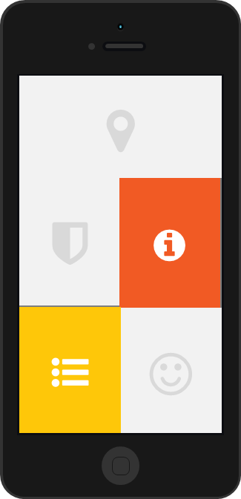
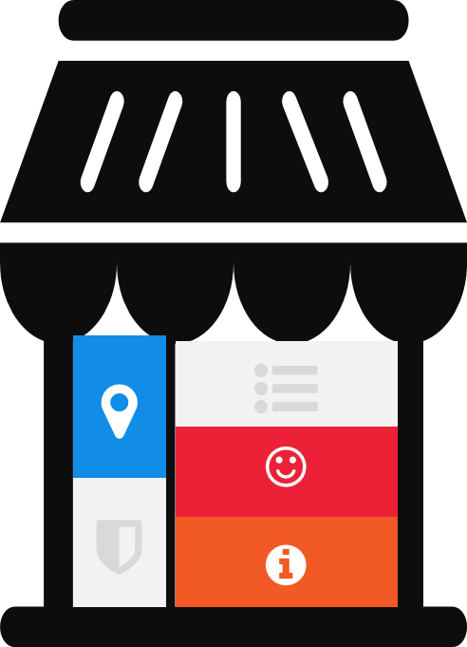
DISTRIBUTION SERVICES AND THE KEY ROLE OF SEPARABILITY
In the context of multichannel operation involving online channels, ICT have brought a dramatic change
ICT allow for the separability of all DS in time and space (Betancourt et al 2016)
Among other relevant implications, separability makes it possible for customers to combine DS from different company’s channels

Slide 10
DISTRIBUTION SERVICES AND THE KEY ROLE OF SEPARABILITY
In a company operating two channels, i.e. B&M and online, separability allows customers to combine DS from the company’s online channel while shopping at one of the company’s retail stores or vice versa
We will refer to this behavior as service blending, which is the equivalent of omnichannel

Slide 11
OMNICHANNEL BEHAVIOR. THE DISTINCTION BETWEEN TWO CUSTOMER ROLES: PURCHASE AND USE
To fully understand omnichannel behavior, we need to put the focus on consumers
For any company operating distribution channels, customers play two roles: purchasers/users

Slide 12
OMNICHANNEL BEHAVIOR. THE DISTINCTION BETWEEN TWO CUSTOMER ROLES: PURCHASE AND USE
Ex: one particular customer purchases products at the company’s web site after getting information about the products in the company’s retail stores (or vice versa)
Ex: another customer, purchases products at the company’s web site and asks the product to be delivered to one retail store located close to her/his office
Ex: another customer never purchases products online and never visits the company’s website ……….

Slide 13
OMNICHANNEL BEHAVIOR. THE DISTINCTION BETWEEN TWO CUSTOMER ROLES: PURCHASE AND USE
A company’s customer is anyone who purchases from the company during a given period of analysis
A company’s user is any company’s customer that interacts with the company (use the DS provided by the company) through either or both channels during the period of analysis

Slide 14
THE SEGMENTATION PROCESS ACCORDING TO THE CUSTOMER ROLES
Taken independently, the two roles would lead to different segmentations of the customer base

Slide 15
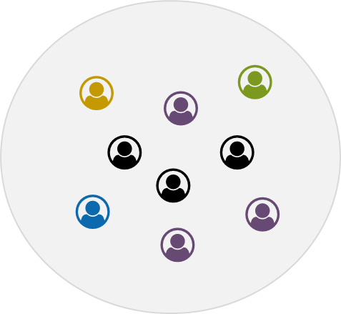
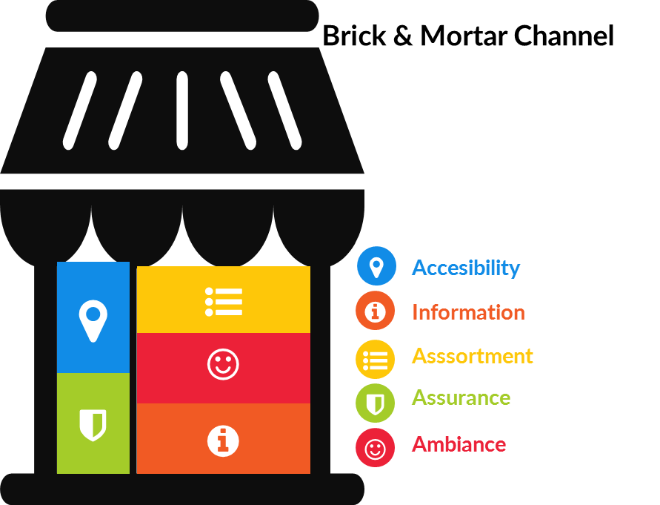

THE SEGMENTATION PROCESS ACCORDING TO THE CUSTOMER ROLES
Consumers
Customers: 100% monochannel
Channel 1

Slide 16

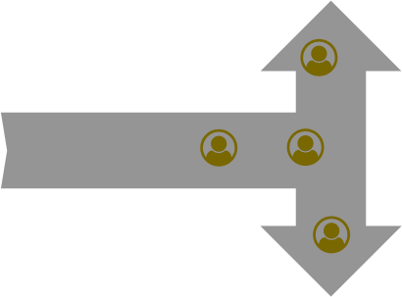

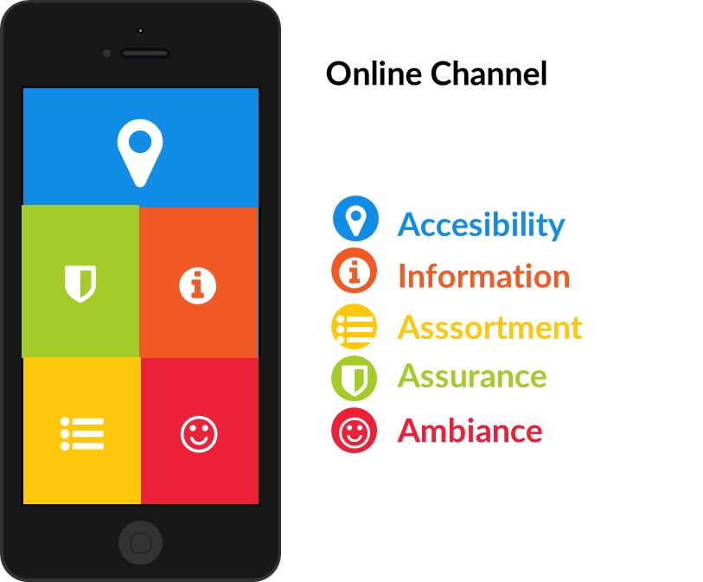
THE SEGMENTATION OF THE CUSTOMER BASE ADDING AN ONLINE CHANNEL: PURCHASE ROLE
Consumers
40% B&M Mono-channel customers
40%
Multichannel customers
20% Online Mono-channel customers

Slide 17


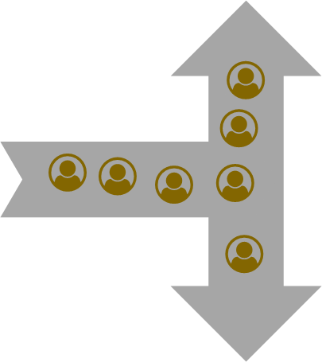

THE SEGMENTATION OF THE CUSTOMER BASE ADDING AN ONLINE CHANNEL: USER ROLE
Consumers
20% B&M Non-Omnichannel customers
70%
Omnichannel customers
10% Online Non-Omnichannel customers

Slide 18
THE EMPIRICAL FRAMEWORK
Objective: Identification of the segments in the multichannel operation of a company with two channels (web and store)
Predict how customers self-select into omni and non-omni customers on the basis of their attitudes and characteristics
Predict how customers self-select into complete an incomplete blenders of DS on the basis of their perceptions of the distribution services offered by both channels as well as other variables

Slide 19
THE EMPIRICAL FRAMEWORK: THE DATA
450 valid responses from customers of a fast fashion retailer company within a panel of online consumers
They provided answers about their shopping behavior and evaluation of DS within the last year
Customers were asked to evaluate the different components of every DS at the store and at the web
Customers were asked about the channel at which they purchased: only store, only web or both
Customers were asked about the use of DS of the alternative channel when purchasing in a channel (service blending)
Other variables: shopping behavior and attitudes, channel policies and general consumer characteristics

Slide 20
THE EMPIRICAL FRAMEWORK: PURCHASE CRITERIA
Customers
450
Monochannel Customers
184
Multichannel Customers
266
|
&
Web
34
Store
150

Slide 21
THE EMPIRICAL FRAMEWORK: USER CRITERIA
USERS
450
non-blenders
(NON-OMNI)
78
Omnichannel Users (blenders)
372
&
Incomplete blenders
106
Complete blenders
266
|
&

Slide 22
SEGMENTATION OUTCOME
Non-Omnichannel users, only web
Monochannel Web Customers
Non-Omnichannel users
(non-blenders)
Non-Omnichannel users, only Store
Monochannel Customers
Customers
Monochannel Web Omnichannel users
Users
Monochannel Store Customers
Omnichannel users,
Incomplete blenders
Monochannel Store Omnichannel users
Omnichannel Users (blenders)
Omnichannel users,
Complete blenders

Slide 23
SEGMENTATION OUTCOME: THE ANALYSIS
Non-Omnichannel users, only web
Monochannel Web Customers
Non-Omnichannel users
(non-blenders)
Non-Omnichannel users, only Store
Monochannel Customers
Customers
Monochannel Web Omnichannel users
Users
Monochannel Store Customers
Omnichannel users,
Incomplete blenders
Monochannel Store Omnichannel users
Omnichannel Users (blenders)
Omnichannel users,
Complete blenders

Slide 24
SEGMENTATION OUTCOME: THE ANALYSIS
Non-Omnichannel users, only web
Monochannel Web Customers
Non-Omnichannel users
(non-blenders)
Non-Omnichannel users, only Store
Monochannel Customers
Customers
Monochannel Web Omnichannel users
Users
Monochannel Store Customers
Omnichannel users,
Incomplete blenders
Monochannel Store Omnichannel users
Omnichannel Users (blenders)
Omnichannel users,
Complete blenders

Slide 25
SEGMENTATION OUTCOME: THE ANALYSIS
Non-Omnichannel users, only web
Monochannel Web Customers
Non-Omnichannel users
(non-blenders)
Non-Omnichannel users, only Store
Monochannel Customers
Customers
Monochannel Web Omnichannel users
Users
Monochannel Store Customers
Omnichannel users,
Incomplete blenders
Monochannel Store Omnichannel users
Omnichannel Users (blenders)
Omnichannel users,
Complete blenders

Slide 26
1ST SEGMENTATION: OMNI CHANNEL VS NON-OMNI CHANNEL MODEL
USERS
450
non-blenders
(NON-OMNI)
78
Omnichannel Users (blenders)
372
&

Slide 27
1ST SEGMENTATION: OMNI CHANNEL VS NON-OMNI CHANNEL MODEL
Model:
Dependent variable: dummy omni channel vs non-omni channel users (1, 0)
Independent variables
Shopping behavior and attitudes
General consumer characteristics
Estimation method
Binary Logit

Slide 28
RESULTS: OMNICHANNEL VS NON-OMNICHANNEL BEHAVIOR
OmniUser vs NonOmni | Coef. | Std. Err. | z | P>z
_cons | 0.629 | 0.615 | 1.020 | 0.307
Attitude NewChannels | 0.827 | 0.284 | 2.910 | 0.004
Brand Past Purchase | 0.180 | 0.076 | 2.370 | 0.018
Experience_STORE | 0.061 | 0.056 | 1.080 | 0.278
Experience _WEB | 0.143 | 0.057 | 2.500 | 0.012
Male | -0.929 | 0.281 | -3.310 | 0.001
Age | -0.029 | 0.012 | -2.350 | 0.019
Montly Income | 0.148 | 0.073 | 2.010 | 0.044
Distance to store (km) | -0.004 | 0.006 | -0.640 | 0.522
Number of obs | 450
LR chi2(8) | 62.350
Prob > chi2 | 0.000
Pseudo R2 | 0.1502

Slide 29
DISCUSSION (I)
Being omnichannel more likely if:
Female
Young
Medium-high income
Purchase frequency of the brand
Innovativeness

Slide 30
2ND SEGMENTATION: COMPLETE BLENDERS VS INCOMPLETE BLENDERS
Omnichannel Users (blenders)
372
&
Incomplete blenders
106
Complete blenders
266
|
&

Slide 31
2ND SEGMENTATION: COMPLETE BLENDERS VS INCOMPLETE BLENDERS
Dependent variable: dummy Complete Blenders vs Incomplete Blenders channel customers (1, 0)
Independent variables
DS at each channel
Channel Policies
Shopping behavior and attitudes
General consumer characteristics
Estimation method
Binary Logit

Slide 32
RESULTS: COMPLETE VS INCOMPLETE BLENDERS
Complete vs Incomplete blenders | Coef. | Std. Err. | z | P>z
_cons | -10.039 | 2.194 | -4.580 | 0.000
DS1(S): Accesibility Products Store | 0.190 | 0.111 | 1.710 | 0.088
DS1(W): Accesibility Products Web | -0.027 | 0.153 | -0.180 | 0.857
DS2(S): Information Store | 0.101 | 0.216 | 0.470 | 0.642
DS2(W): Information Web | -0.241 | 0.237 | -1.020 | 0.308
DS3(S): Assortment Store | 0.067 | 0.170 | 0.390 | 0.695
DS3(W): Assortment Web | -0.424 | 0.209 | -2.030 | 0.042
DS4F(S): Assurance Form Store | -0.091 | 0.239 | -0.380 | 0.704
DS4F(W): Assurance Form Web | 0.160 | 0.213 | 0.750 | 0.453
DS4T(S) : Assurance Time Store | -0.329 | 0.172 | -1.910 | 0.056
DS4T(W) : Assurance Time Web | 1.208 | 0.297 | 4.070 | 0.000
DS5(S): Ambiance Store | 0.123 | 0.185 | 0.670 | 0.505
DS5(W): Ambiance Web | 0.131 | 0.238 | 0.550 | 0.583
Access(S) | 0.163 | 0.131 | 1.250 | 0.212
Access(W) | -0.064 | 0.164 | -0.390 | 0.699
Return(S) | -0.190 | 0.227 | -0.840 | 0.402
Return(W) | 0.130 | 0.198 | 0.660 | 0.509
Paym(S) | -0.178 | 0.256 | -0.690 | 0.488
Paym(W) | 0.064 | 0.181 | 0.350 | 0.724
priv(W) | 3.108 | 0.417 | 7.460 | 0.000
Brand.prices | -0.002 | 0.145 | -0.020 | 0.988
Sending fees(W) | -0.065 | 0.148 | -0.440 | 0.661
Attitudes | 0.690 | 1.092 | 0.630 | 0.527
Characteristics | 2.796 | 1.847 | 1.510 | 0.130
Number of obs 372
LR chi2(23): 269.050
Prob > chi2: 0.000
Pseudo R2: 0.605

Slide 33
DISCUSSION (II)
Being complete blender (purchasing at both channels) is more likely than incomplete blender (purchasing in one channel and using services of both) if:
Store location is convenient
Assortment in the online channel is low
Assurance in time is high in the online channel and low in the store channel

Slide 34
TWO CAVEATS
The role of DS depends partly on the relative share of each channel in one context
Great differences between product categories (i.e. apparel, music, videogames, electronics..)

Slide 35
FUTURE STEPS
All segments, reaching the last level: the five segments (modelization and estimation procedure)
Segmentation Results: Relationship with satisfaction and loyalty

Slide 36
THANK YOU!
Madrid, January 26-28 2017

Slide 37
DESCRIPTIVE STATISTICS: DS
Variable |  | Mean | Std. Dev.
Access store | Indique en qué medida la compra en establecimientos físicos de ZARA le permite poder recibir los productos comprados en el lugar donde a Vd. le conviene (hogar, trabajo, establecimiento físico de Zara, otros establecimientos, …) | 7.00 | 2.265
Access web | Indique en qué medida ZARA online le permite poder recibir los productos comprados en el lugar donde a Vd. le conviene (hogar, trabajo, establecimiento físico de ZARA, otros establecimientos, …) | 7.79 | 1.932
Inform store | Indique en qué medida es suficiente la información que le proporciona el establecimiento físico de ZARA sobre las características de los productos: precio, forma de uso, talla, composición,... | 7.66 | 1.671
Inform web | Indique en qué medida es suficiente la información que le proporciona la página web de ZARA sobre las características de los productos: precio, forma, talla, composición,... | 7.62 | 1.599
Assortm store | Indique en qué medida encuentra que las distintas alternativas ofrecidas por los establecimiento físico de ZARA (diferentes tallas, diferentes modelos, …) son suficientes para realizar su compra | 7.43 | 1.707
Assortm web | Indique en qué medida encuentra que las distintas alternativas ofrecidas por la página web de ZARA (diferentes tallas, diferentes modelos, ... )son suficientes para realizar su compra | 7.42 | 1.775
AssForm store | Cuando compra los productos a través de establecimientos físicos de ZARA, indique en qué medida las características de los productos recibidos se ciñen, en general, a lo que espera de los mismos | 7.62 | 1.530
AssForm web | Cuando compra los productos a través de la página web de ZARA, indique en qué medida las características de los productos recibidos se ciñen, en general, a lo que espera de los mismos | 7.20 | 1.792
AssTime store | Indique en qué medida el tiempo que mantiene ZARA los mismos productos en sus establecimientos físicos le permite poder realizar su compra cuando lo desea | 7.09 | 1.740
AssTime web | Indique en qué medida el tiempo que mantiene ZARA los mismos productos en página web le permite poder realizar su compra cuando lo desea | 7.28 | 1.874
 | Indique en qué medida el plazo de entrega de los productos que adquiere en ZARA online le permite usar el producto en el momento deseado | 7.19 | 1.869
Ambience store | Indique en qué medida el trato de los empleados de los establecimientos físicos de ZARA le facilitan realizar su compra de forma agradable | 7.60 | 1.818
 | Indique en qué medida el orden y limpieza de los establecimientos físicos de ZARA le facilitan realizar su compra de forma agradable | 7.58 | 1.800
 | Indique en qué medida las posibilidades de interacción social con otros clientes en los establecimientos físicos de ZARA le facilitan realizar su compra de forma agradable | 7.05 | 2.158
Ambience web | Indique en qué medida el aspecto de la página web de ZARA le resulta atractivo | 7.63 | 1.643
 | Indique en qué medida la página web de ZARA le proporciona un claro directorio de los productos y servicios que ofrece la empresa | 7.61 | 1.544

Slide 38
DESCRIPTIVE STATISTICS: CHANNEL POLICIES
Variable | Mean | Std. Dev.
Indique en qué medida le resulta fácil acceder a la página web de ZARA | 8.43 | 1.63
Indique en qué medida el procedimiento de devolución de los productos establecido por los establecimientos físicos de ZARA se ajusta a sus necesidades | 7.81 | 1.67
Indique en qué medida el procedimiento de devolución de los productos establecido por ZARA online se ajusta a sus necesidades | 7.28 | 1.87
Indique en qué medida las modalidades de pago ofrecidas por los establecimientos físicos de ZARA se ajusta a sus necesidades | 8.20 | 1.57
Indique en qué medida las modalidades de pago ofrecidas por ZARA online se ajusta a sus necesidades | 7.79 | 1.75
Indique en qué medida la información que obtiene sobre la política de privacidad y seguridad seguida por la página web de ZARA le aporta tranquilidad en sus compras | 2.26 | 1.20
Indique en qué medida los precios de ZARA en sus establecimientos físicos, en relación a otras marcas son + Indique en qué medida los precios de ZARA en su página web | 6.27 | 1.59
Indique en qué medida los gastos de envío de ZARA online, en relación a otros establecimientos online le parecieron | 5.80 | 1.70

Slide 39
DESCRIPTIVE STATISTICS: Attitudes and Customer Characteristics
Variables | Mean | Std. Dev.
Actitud innovadora ante el uso de nuevos canales | 0.51 | 0.50
En su experiencia de compra en los últimos 12 meses, ¿cuántas de sus compras han sido de la marca ZARA? | 4.13 | 2.23
De cada 10 veces que compra en establecimientos físicos de marcas similares a ZARA, ¿cuántas veces lo hace en establecimientos físicos de ZARA? | 6.03 | 2.56
De cada 10 veces que compra a través de páginas web de marcas similares a Zara, ¿cuántas veces lo hace en la página web de ZARA? | 4.86 | 2.86
Sexo | 0.40 | 0.49
Edad | 37.00 | 11.39
Nivel de ingresos | 3.86 | 2.19
Distancia a la tienda más cercana | 14.80 | 21.67

Slide 40
OUR PERSPECTIVE AND THE PREMISES
A retailer wants to understand the customer behavior.
If omni customers behave differently than non-omni customers, this is likely to affect their purchase decisions and, thus, profits, sales and growth
Our perspective is that DS are the core component for modelling the shopping multichannel and omnichannel behaviors
The premises are: (1) The demand of DS levels by customers varies between shopping occasions, (2) there are inter-channel differences in the DS levels provided, and (3) Customers try to optimize the mix of DS consumed in every shopping occasion

Slide 41
THE SEGMENTATION OF THE CUSTOMER BASE
With these premises, for companies operating with a multichannel customer strategy (Verhoef et al 2007), the transversal provision of DS services conveniently connected would result in a natural segmentation of their customer base in terms of the channel choice and the DS blending behaviors

